Slide 1
TSP Introduction
Nick Huang

Slide 2
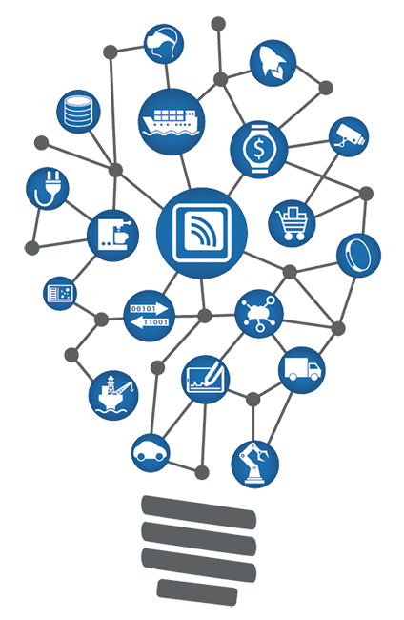
MQTT
Architecture
Unit Test
圖片來源: https://www.rewiresecurity.co.uk/iot-internet-of-things-solutions

Slide 3
MQTT

Slide 4
Why MQTT

Slide 5
Application Layer protocol base on TCP
Lightweight and Fast (Header 2 bytes)
Keep TCP connection alive
詳細介紹請參考文章: https://swf.com.tw/?p=1002

Slide 6
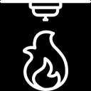
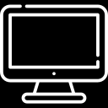
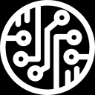
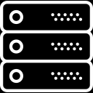
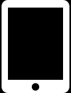
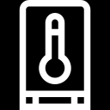
Client
Server
Client
Publisher
MQTT Broker
Subscriber
[Topic] /SmokeDetector [Payload] trigger: true
[Topic] /SmokeDetector [Payload] trigger: true
[Topic] /IoT [Payload] test
[Topic] /IoT [Payload] test
[Topic] /SmokeDetector [Payload] trigger: true
[Topic] /Thermometer
[Payload] 35℃
[Topic] /Thermometer
[Payload] 35℃

Slide 7
MQTT QoS

Slide 8

QoS 0 : 最多傳送一次 (TSP project採用)
QoS 1 : 至少傳送一次
QoS 2 : 確實傳送一次
快
慢
詳細介紹請參考文章: https://swf.com.tw/?p=1015

Slide 9
MQTT Module

Slide 10

LocalBroadcastManager
Developer
<sealed class> Result
XMLCommand
Success(data: T)
Failure(error: XMLCommandError)
MQTTNetworkReceiver
MQTTNetworkService
<<Interface>> MQTTNetworkServiceInterface
TPCipher
MQTTNetworkManager
<<Interface>> MQTTNetworkManagerInterface
MqttAndroidClient

Slide 11
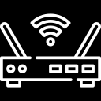
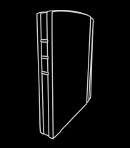
AP
LAN
Pad
Panel

Slide 12
TouchPad
Panel Broker/Client
(1) UDP Broadcast ’SEARCH’ packet
(2) Response Panel’s Mac/IP
(3) Connect to MQTT Server
(4) Connect Ack (Success/failure)
(5) Publish secret data information (Topic: SESSION)
(6) Verify data
(8) Verify data
(7) Publish secret data information (Topic: SESSION)
(9) Publish command data (Topic: REQUEST)
Encrypt
Decrypt
(10) Publish response data (Topic: RESPONSE)
Decrypt
Encrypt
(11) Publish notify data (Topic: NOTIFY)
Decrypt
Encrypt

Slide 13
MVP

Slide 14
Why MVP

Slide 15
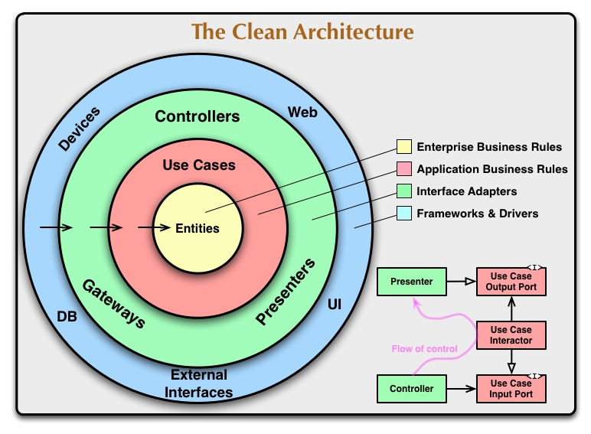
圖片來源: https://blog.cleancoder.com/uncle-bob/2012/08/13/the-clean-architecture.html

Slide 16
Readable
Understandable
Maintainable
Testable

Slide 17
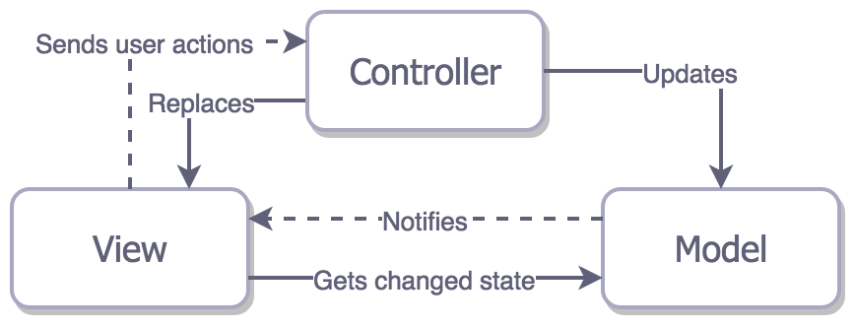
MVC
圖片來源: https://cg2010studio.com/2016/06/02/mvc與mvp/

Slide 18
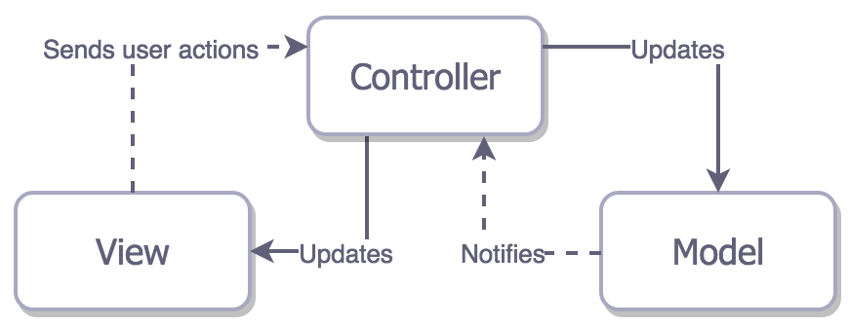
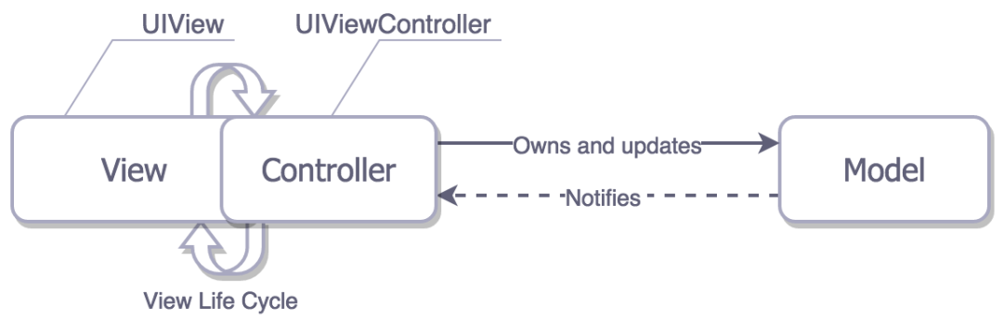
Apple定義的MVC
實際開發上
圖片來源: https://cg2010studio.com/2016/06/02/mvc與mvp/

Slide 19
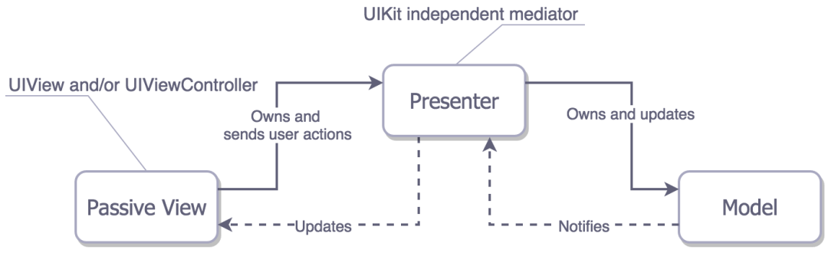
MVP
圖片來源: https://cg2010studio.com/2016/06/02/mvc與mvp/

Slide 20



View
Presenter
Model
Shared Preference
Activity
Presenter
Interactor
Database API
Fragment
Presenter
Interactor
REST API
View
MQTT API

Slide 21
View: 負責UI繪製呈現邏輯，接收User交互事件。 設置View, 跳轉頁面程式碼, 接收User點擊事件並傳給Presenter做處理
Presenter: 負責UI更新邏輯，處理User交互邏輯，業務邏輯等...。 接收來自View的點擊事件, 處理業務邏輯, 呼叫Model取資料, 呼叫View更新視圖＊純Kotlin/Java檔，不能牽扯UI Framework (android.view.* 等...)，易測試
Model: 負責data/model相關邏輯。 操作Database, 網路請求, SharedPreference/UserDefault存取的程式碼 等...
Contract: 定義View/Presenter/Model的交互接口

Slide 22
Why Unit Testing

Slide 23
確保程式碼品質
測試自動化
好抽換模組
好維護
測試代碼可以當Spec看

Slide 24
Code

Slide 25
Q&A

Slide 26
Reference
android-architecture (Google sample code)
Getting Started with MVP (Model View Presenter) on Android
The Clean Architecture
What Is Clean Code?
MQTT教學
MVP與MVP

Slide 27
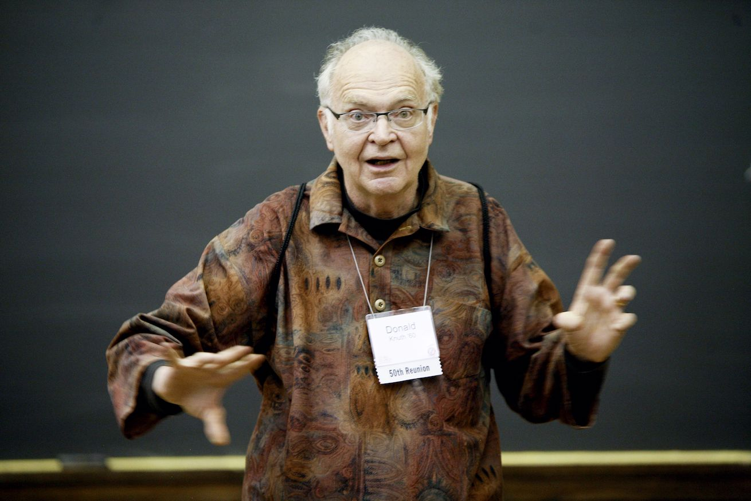
圖片來源: https://www.pinterest.com/pin/152559506104070488/?nic=1
「Programming is not about telling the computer what to do. Programming is the art of telling another human what the computer should do.」
–Donald Knuth

